Slide 1

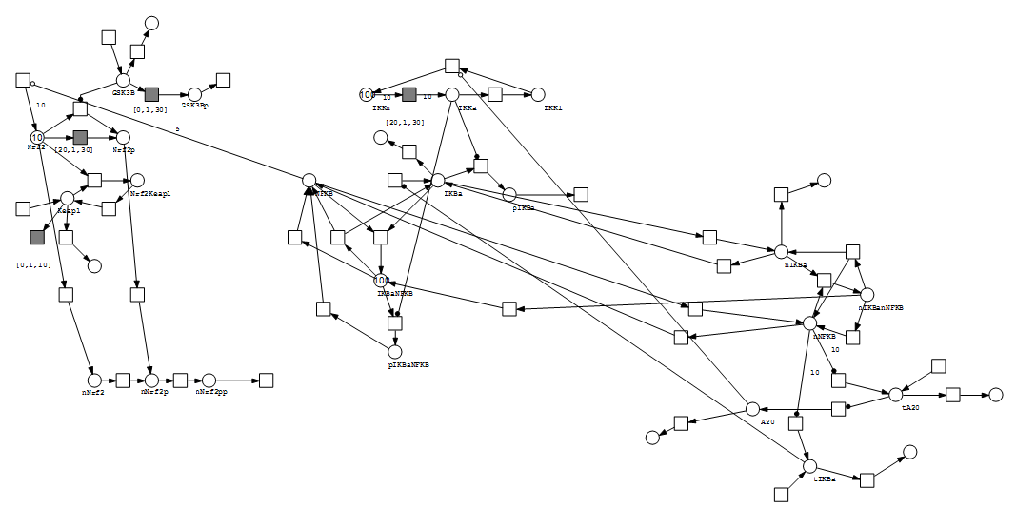
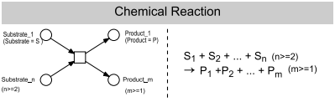
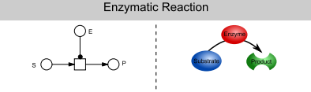
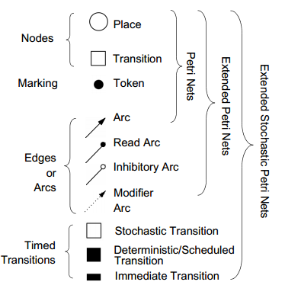
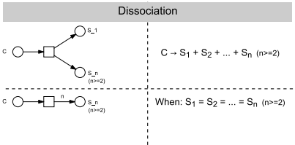
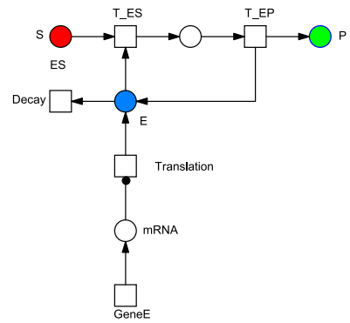
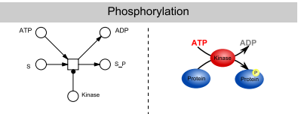
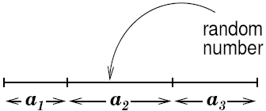
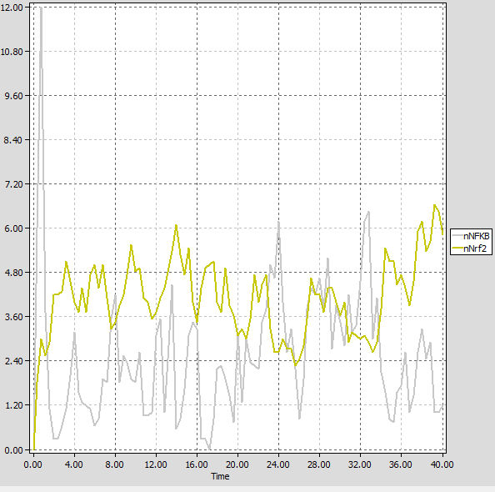
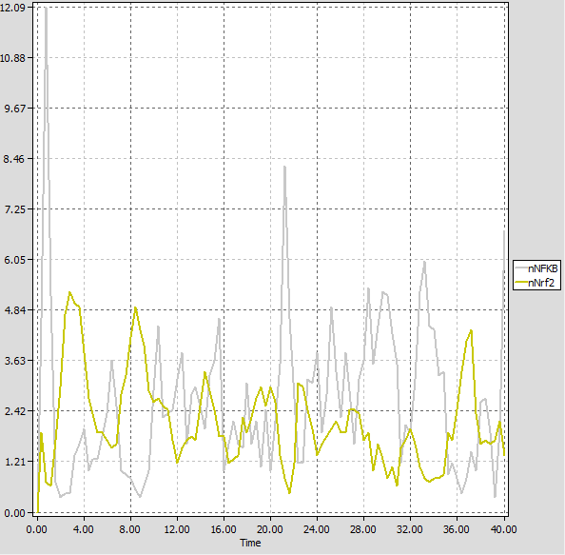
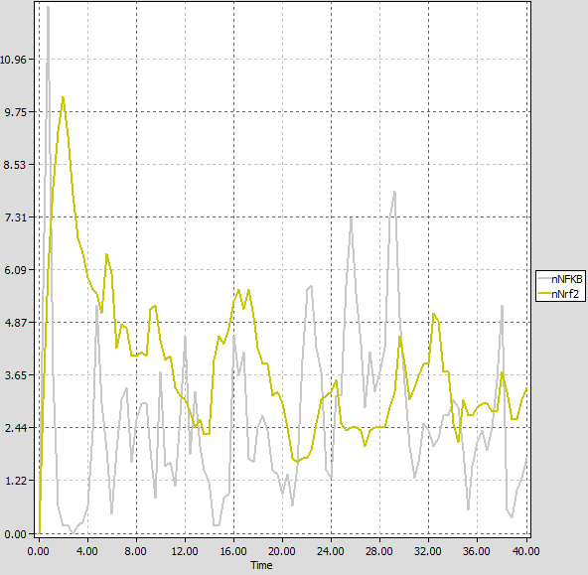
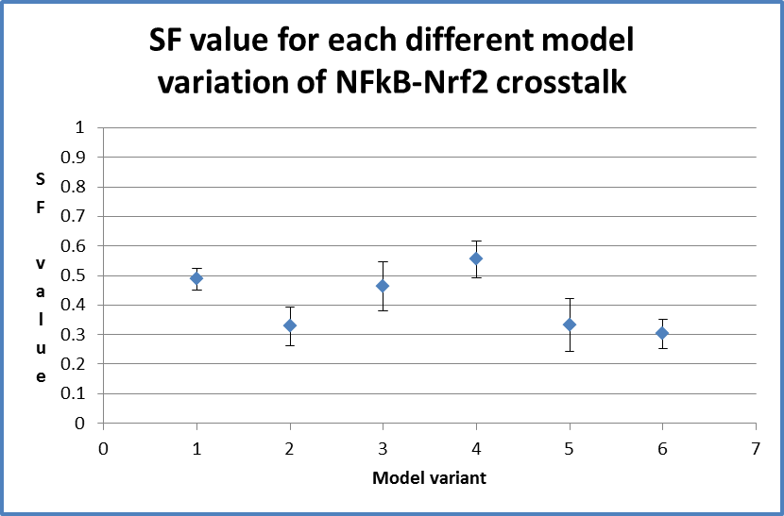
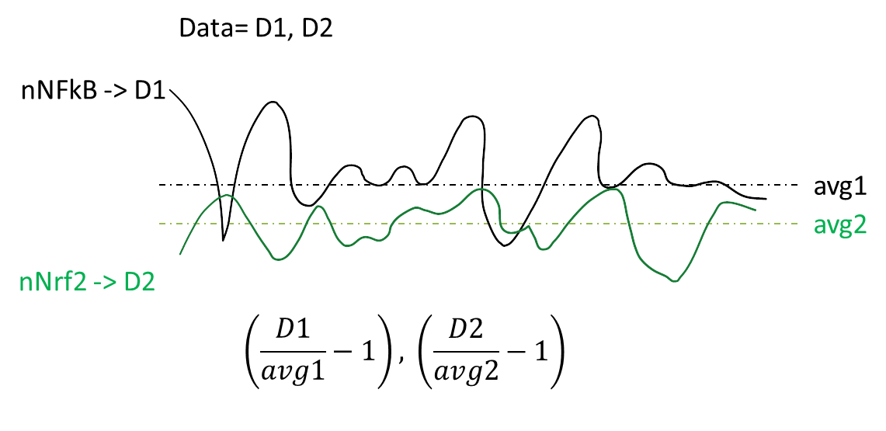
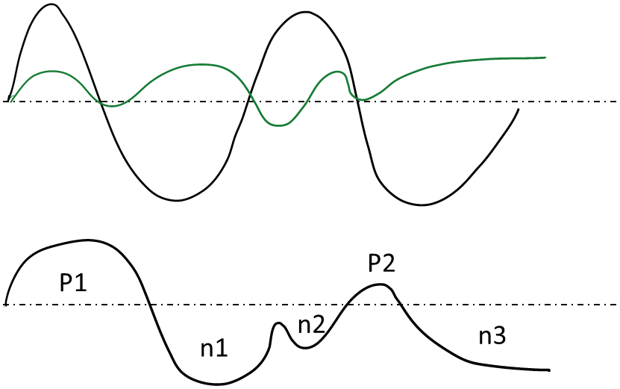
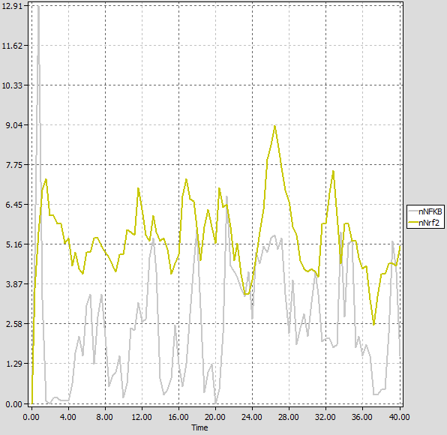
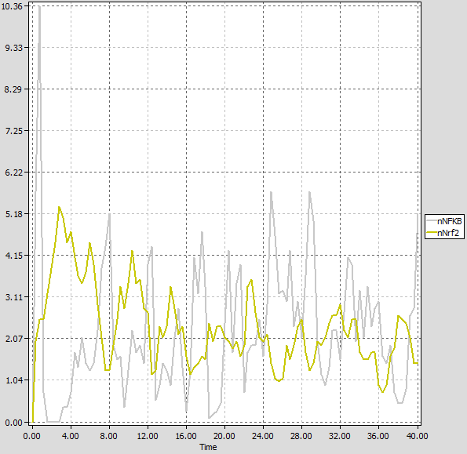
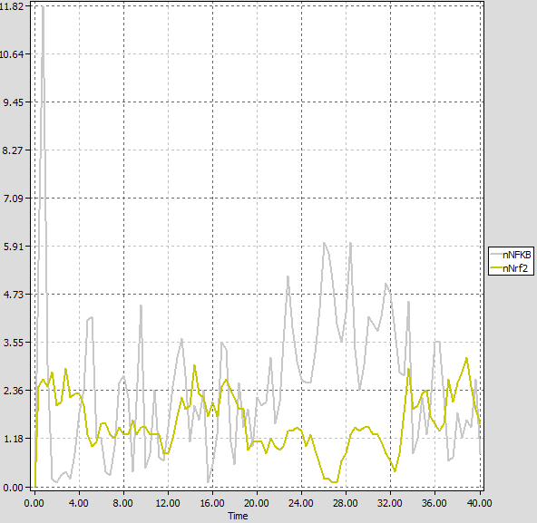
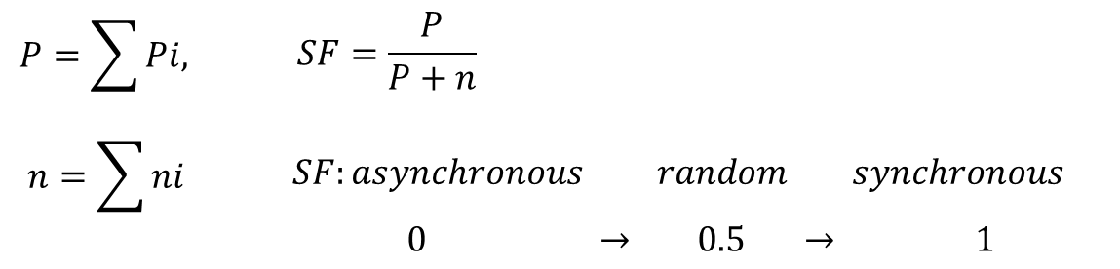
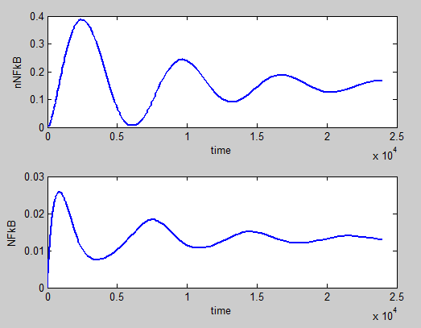
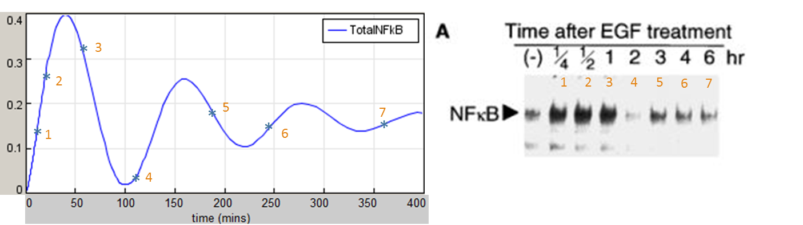
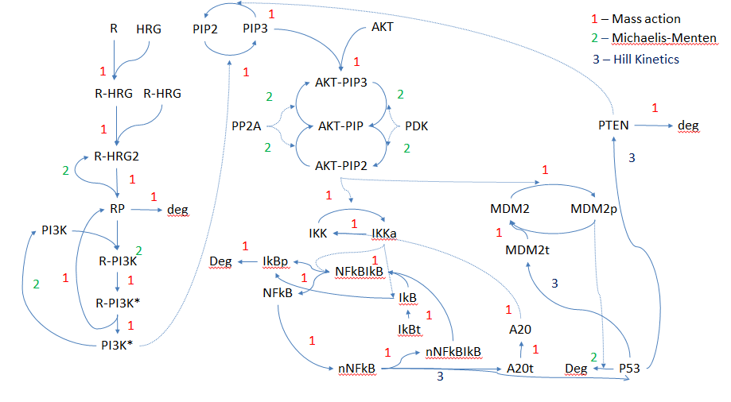
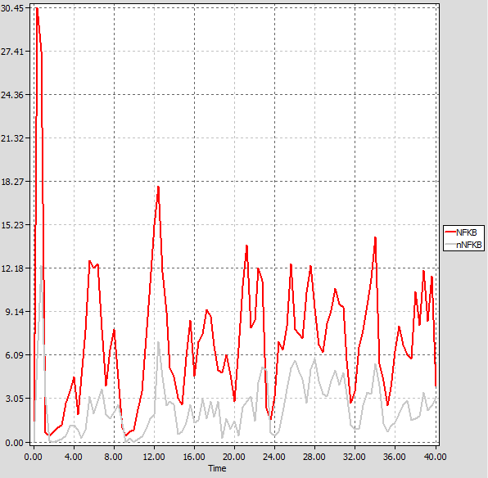
Connectivity effects for NFkB-NrF2 crosstalk, a quantitative Petri-Net analysis approach
Carlos Andres Mariscal Melgar(MRes student)
Supervisor: Dr Steven Webb
MRC Centre for drug safety science, University of Liverpool, Liverpool , UK
Introduction
Nuclear Factor kappa B(NFkB) is a family of transcription factors that plays a prominent role in innate immune response. Upon stimulation by cellular stress, a kinase cascade is activated, which eventually strips the NFkB of its inhibitor IκBα molecule and allows it to translocate into the nucleus. In the nucleus NFkB acts as a transcription factor and has an important role for cell survival.
Nuclear factor erythroid 2–related factor 2(Nrf2) is a master regulator of transcriptional activation of genes encoding cytoprotective proteins.
Aim
Use mathematical modelling to evaluate whether crosstalk between the regulatory pathways of NFkB and Nrf2 can produce asynchronous oscillations in the nuclear concentrations of NFkB and Nrf2.
Provide leads to identify the mechanisms of crosstalk most likely to produce asynchronous oscillations under Tumour Necrosis Factor α (TNF-α) stimulation.
NFkB-Nrf2 Crosstalk graphical Petri-Net notation
Figure 1: Bipartite graphic notation for both NFkB and Nrf2, this graphical notation is representative for variation number 5 which presented the most likely candidate for Asynchronous oscillations in the Cross-talk.
f
Graphical representation of Biochemical events
Petri-net properties
Petri-Net simulation algorithm
Chemical Reaction
Enzymatic Reaction
Petri net elements
Petri net elements and their graphical representation. Petri nets are
weighted, directed, bipartite graphs consisting of nodes and arcs. The nodes
of a Petri net, the places and transitions, are interconnected by arcs. An arc
always connects a place with a transition or vice versa, but never two places or
two transitions with each other. Places may contain (be marked with) tokens,
while transitions can not contain any tokens. As in the qualitative case,
a stochastic Petri net maintains a discrete number of tokens on its places. But
contrary to the time-free case, a stochastic ﬁring rate is associated with each transition, determining a stochastic waiting time before an enabled transition
actually ﬁres.
Gillespie Algorithm
Dissociation Reaction
Enzymatic Reaction coupled with Gene expression
Initialise the Stochastic Petri-Net (SPN) network with the chosen initial marking
Calculate the ﬁring rates of all enabled transitions using their rate functions
Calculate the combined rate by summing up all transition rates
Determine the time interval until the next state change takes place. This is done by computing an exponentially distributed random number depending on the current combined transition rate of the net (below)
Increase the simulation time by this time interval
Determine the next system state change. For this purpose, a weighted random selection of the transition is made which gets the license to ﬁre
Let the selected transition ﬁre and update the marking of the SPN
Go back to step 2, if the simulation time has not yet reached its end point
Phosphorylation
Figure 2 Random number associated and placement among weighted probability of firing (represented by size of a1;a2;a3)
Different tested variations of NFkB-Nrf2 crosstalk
Validation: Synchrony Factor
Variant 1: Nrf2 and NFkB simulated independently
Variant 2: Nuclear NFkB induces GsK3B production in the nucleus
Variant 3: Cytoplasmic NFkB induces Keap1:Nrf2 binding in cytoplasm
0
0
Figure 7: Synchrony factor in relation to each one of the NFkB-Nrf2 crosstalk models
0.5->1 synchronous behaviour ; 0.5->0 asynchronous behaviour ; 10 simulations each.
Variant 4: Cytoplasmic NFkB induces de-phosphorylation of Nrf2 in cytoplasm
Variant 5: NFkB inhibits de novo synthesis of Nrf2 in cytoplasm
Variant 6: NFkB inhibits de novo synthesis of Nrf2 at 20% rate of variant 5
Conclusion
This project shows the potential of Petri-net analysis in elucidating signaling pathway behaviour..
Synchrony factor values suggest that Gsk3B induction by NFkB and de novo synthesis of Nrf2 inhibition by NFkB should be explored further in a laboratory setting as potential points of crosstalk between NFkB and Nrf2, therefore explaining the occurrence of asynchronous oscillations.
Comparison Petri-Net model with MATLAB ODE NFkB Model
Summary
Quantitative Petri-Net analysis can be applied successfully to signaling pathway studies that find difficulty in obtaining kinetic data, because of the size of the pathway or experimental limitations
Signaling pathway modelling can therefore guide experimentalist to the most likely answer
Asynchronous behaviour in the NFkB-Nrf2 crosstalk seems to be related to either Gsk3B modulation by NFkB or de novo synthesis of Nrf2 inhibition
Figure 5: NFkB + nNFkB = TotalNFkB in comparison to Ohtsubo’s Western blot NFkB expression levels (1)
Figure 3: nNFkB and NFkB time course simulation based on ODE model using kinetic parameters
Literature
1) Ohtsubo M, Takayanagi A, Gamou S, Shimizu N. Interruption of NF kappa B-Stat1 signaling mediates EGF-induced cell-cycle arrest. J Cell Physiol. 2000;184(1):131-7.
2) Ghosh S, Karin M. Missing pieces in the NF-kappaB puzzle. Cell. 2002;109 Suppl:S81-9
3) Oeckinghaus A, Hayden MS, Ghosh S. Crosstalk in NF-kappaB signaling pathways. Nat Immunol. 2011;12(8):695-708
Figure 4: nNFkB and NFkB quantitative petri-net simulation showing delayed asynchronous oscillations(no kinetic parameters; not time dependent)
Figure 6: NFkB signal transduction pathway modelled in MATLAB using the ODE method. Use of either Mass Action, Hill Kinetics or Michaelis-Menten Kinetics is highlighted.
Acknowledgments
I would like to thank Dr Steven Webb and Dr Ian Sorrel for their continuing support during this project.

